Slide 1
Library management system (lms) capstone project
FULL STACK WEB DEVELOPMENT PROJECT
Presented by : Siti Haida
Date of presentation: 1st April 2025
Notes:
Good evening everyone, I’m Aida and I spent way too many hours on this project.
It started well until it went downhill — I restarted the project twice, almost gave up, also gave up, had a meltdown…
But in the end, I managed to persevere, and I’m proud of myself that I completed it, despite not having any programming background at the start of this course.

Slide 2
Project overview
A web application designed to manage library operations
Supports two main user roles:
Librarian (Admin): manages users, books, and borrowing records
Member: searches, borrows, and returns books
Built using:
Spring Boot (Backend),
React.js (Frontend),
MySQL (Database).
Notes:
The Library Management System is a full-stack web application developed to simplify day-to-day library operations.
It includes two main user roles: Librarians who manage the system, and Members who use it to search, borrow, and return books.
The project uses Spring Boot for the backend, React for the frontend, and MySQL to handle all data storage."

Slide 3
Project goals
Build a fully functional library system using Java Spring Boot, React, and MySQL.
Help librarians manage books, members, and borrowing history more efficiently.
Provide a smooth and user-friendly experience for both admin and member users.
Design a scalable system with clean code and proper architecture, despite being a beginner.
Notes:
My goal was to build a fully functional Library Management System using the tech stack we learned: Spring Boot, React, and MySQL.
I wanted librarians to easily manage books and members, and for members to have a nice experience searching and borrowing books.
I also challenged myself to make the system scalable and structured well.

Slide 4
Key features
User Management: Registration, login, and password reset.
Member Management: Add, edit, delete, and search members (admin only).
Book Management: Add, update, delete, and search books with filters.
Lending Management:
Members: Borrow and reserve books
Admins: Return books
Borrowing History: Viewable by admin per member
Notes:
These are the key features I implemented.
Users can register, log in, and reset their password.
Librarians manage members and books — they can add, update, and search easily.
Members are allowed to borrow and reserve books. However, only admins can mark books as returned.
Admins can also view borrowing histories for each member.

Slide 5
Business rules
Borrowing Limit:
Members can borrow up to 3 books at a time
Reservations:
Members can reserve a book if it's already borrowed
Once returned, the reserved user can borrow it
Return Policy:
Only admins can perform book returns
Borrowing Conditions:
Members cannot borrow if they already have 3 active borrowings
Notes:
The main rule I implemented is a borrowing limit — members can borrow up to three books at any time.
If a book is already borrowed, members can reserve it.
Once the book is returned by the current borrower, it becomes available to the member who made the reservation.
Also, only admins can return books.
I didn’t implement fines or due dates, but I made sure core borrowing and reservation logic works smoothly.

Slide 6
Technical requirements
Backend:
Spring Boot (Java)
RESTful API
Spring Security (JWT-based authentication)
JPA/Hibernate for database access
Frontend:
React.js (with Vite)
React Router
Axios for API requests
Bootstrap for styling
Database:
MySQL
Entity relationships: users, books, borrowings, reservations
Data integrity: enforced through proper constraints
Notes:
On the backend, I used Spring Boot to build a RESTful API with JWT-based authentication and role-based access.
I used JPA with Hibernate for all the database interactions.
On the frontend, I built the app with React and used Vite for faster builds, React Router for navigation, and Axios for API calls.
The database is MySQL, and I structured it with relationships between users, books, borrowings, and reservations.
Data integrity is managed with proper constraints in the schema.

Slide 7
System Architecture
Architecture Pattern: Model-View-Controller (MVC)
Layers:
Model: JPA Entities (e.g. User, Book, Borrowing)
View: React frontend (Vite-based, component-driven)
Controller: Spring Boot REST Controllers
Flow:
Frontend (React) sends HTTP requests via Axios
Backend (Spring Boot) processes logic & database interaction
Data stored in MySQL, returned via REST API
Notes:
I followed the MVC architecture, which helped me organise the system into three clear parts.
The Model represents my data structures — like Users, Books, and Borrowings — using JPA entities.
The Controller layer handles requests using Spring Boot REST endpoints.
The View is the React frontend — it communicates with the backend using Axios, and displays data dynamically.
This clear separation made it easier for me to manage logic and debug each part independently.

Slide 8
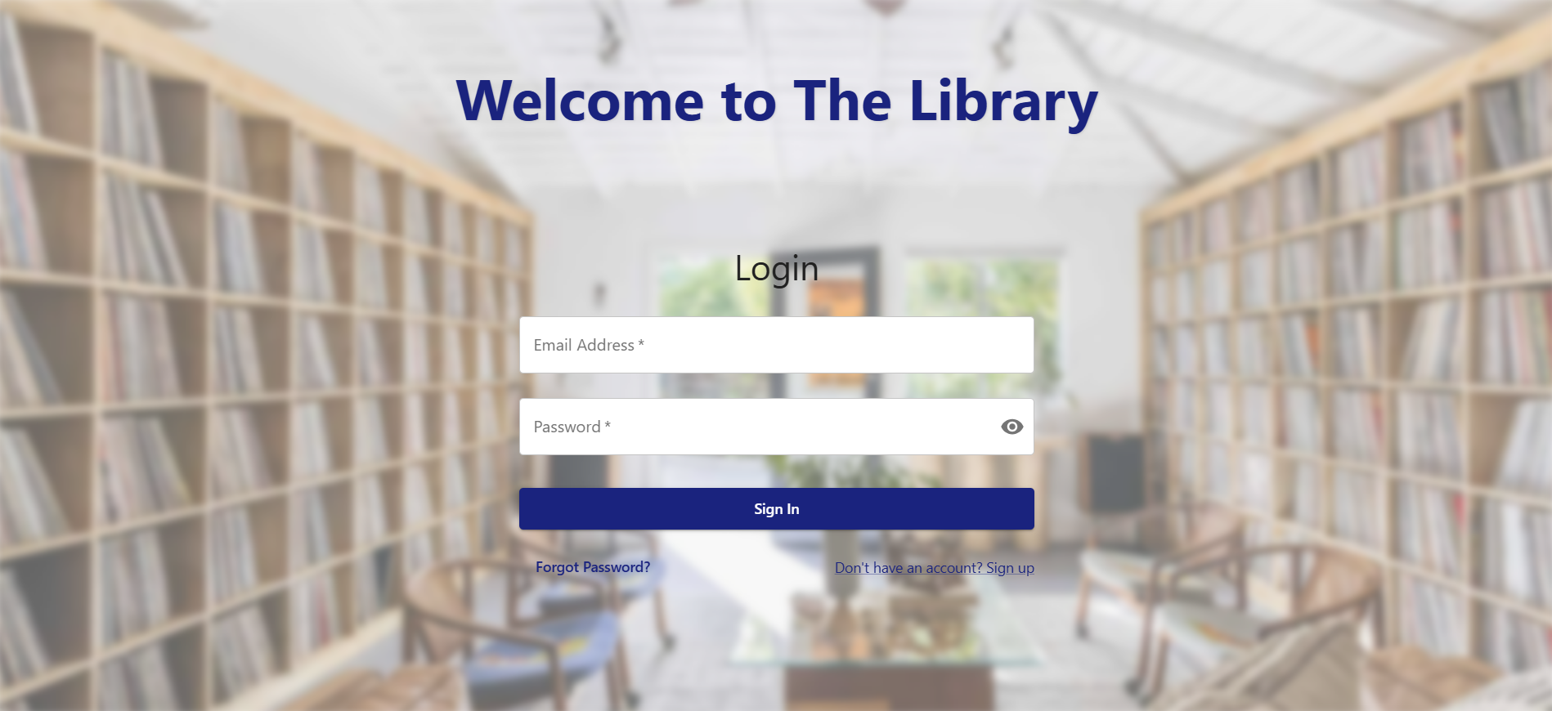
Key features
User login page
Notes:
Let me show you some of the key pages I created for this system.
First, here is the User Login Page, which is the entry point for both admins and members. Once logged in, users are directed to their respective dashboards.

Slide 9
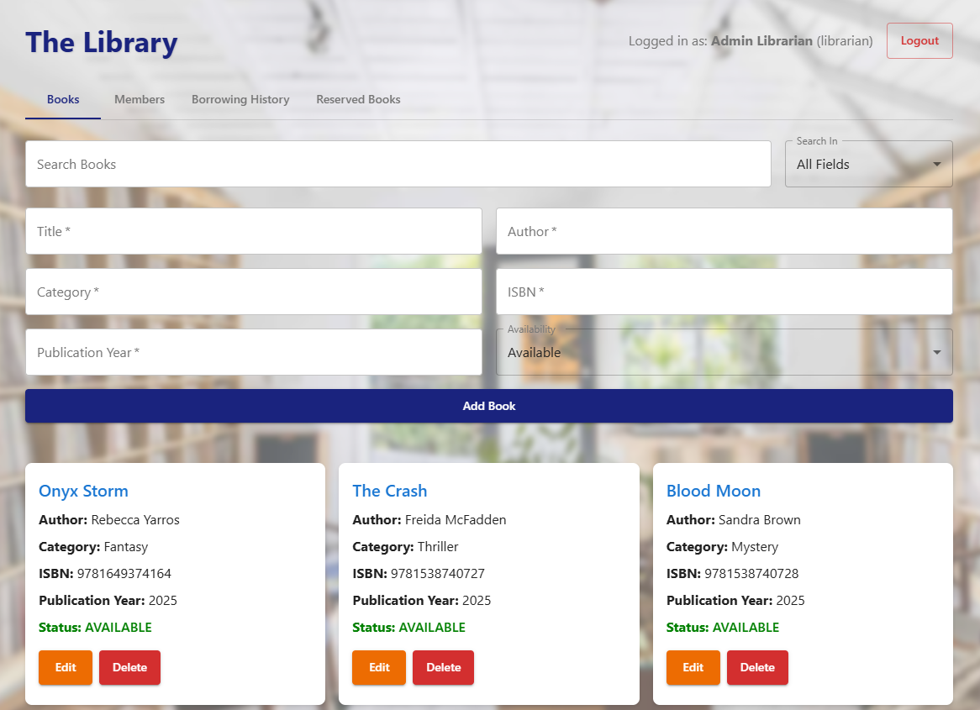
Key features
Book Management page
Admin View
Notes:
Next is the Book Management Page, available to admins. From here, they can view all books, update details, or delete entries.

Slide 10
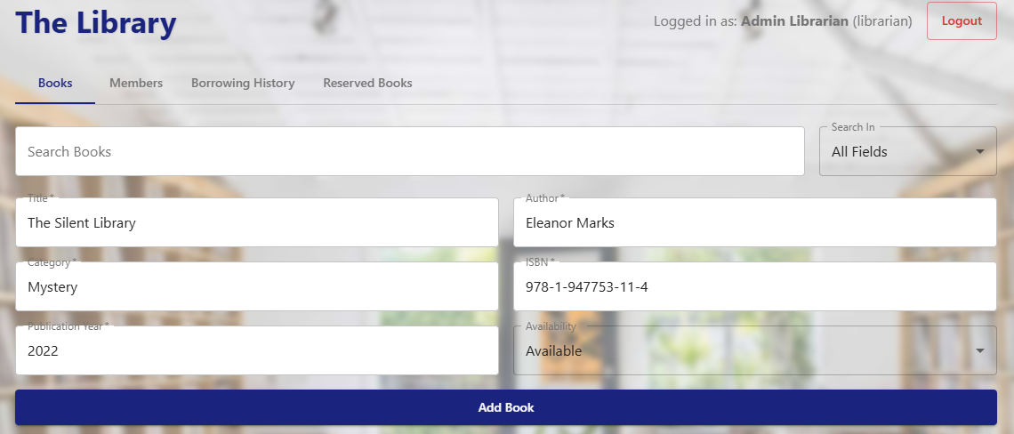
Key features
Add book page
Admin View
Notes:
There’s also a separate Add Book Page to register new books into the system.

Slide 11
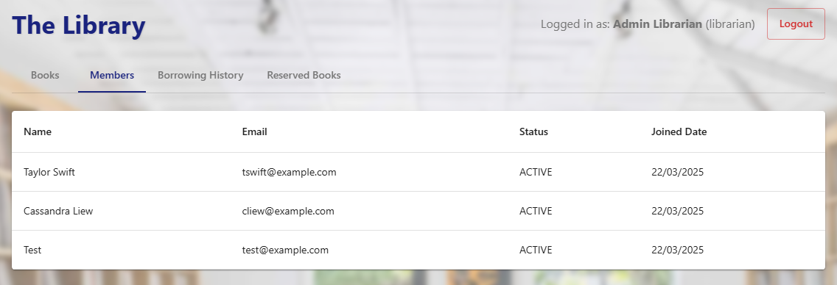
Key features
Member Management page
Admin View
Notes:
Then we have the Member Management Page, also for admins, where they can view active members and their joined date.

Slide 12
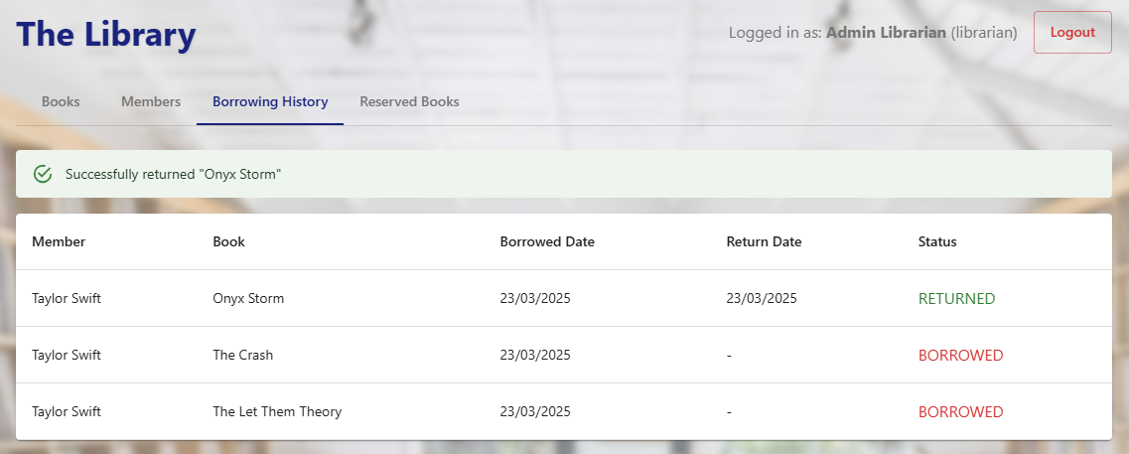
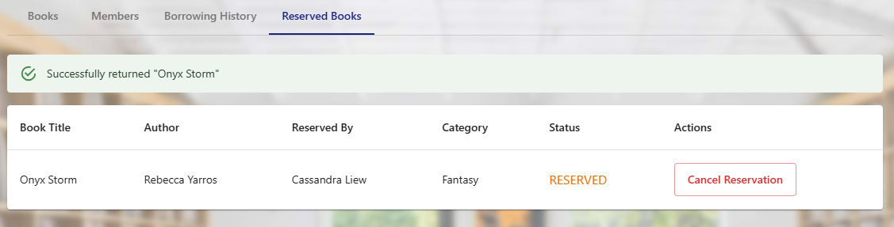
Key features
Return & borrowing pages
Admin View
Notes:
This is the Return and Borrowing Page for admins — they can view current borrowings, and also access borrowing history for each user.

Slide 13
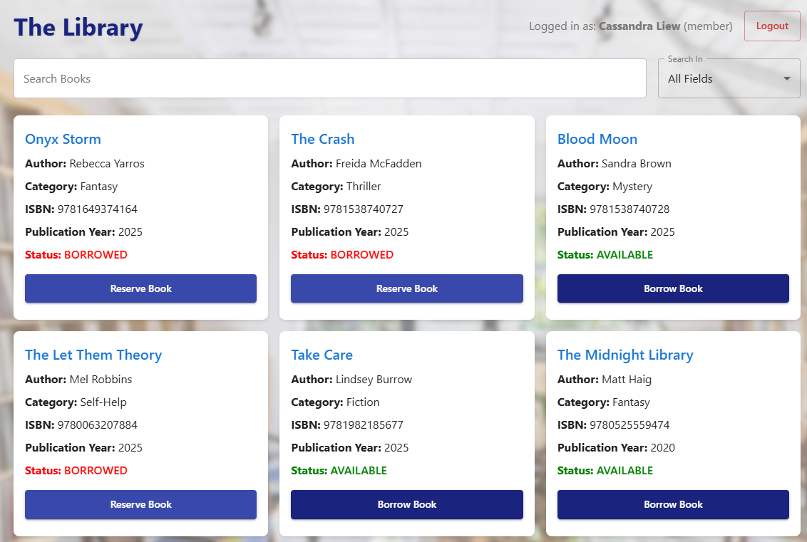
Key features
Book search & borrow
Member View
Notes:
On the member side, users can go to the Book Search page to explore available books and borrow them if they’re not already taken.

Slide 14
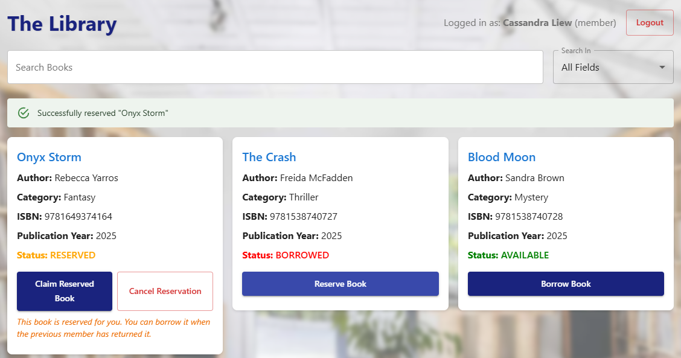
Key features
Reservation feature
Member View
Notes:
If a book is already borrowed, members can use the Reservation Feature to reserve it. When the book is returned, it becomes available for the member who made the reservation.

Slide 15
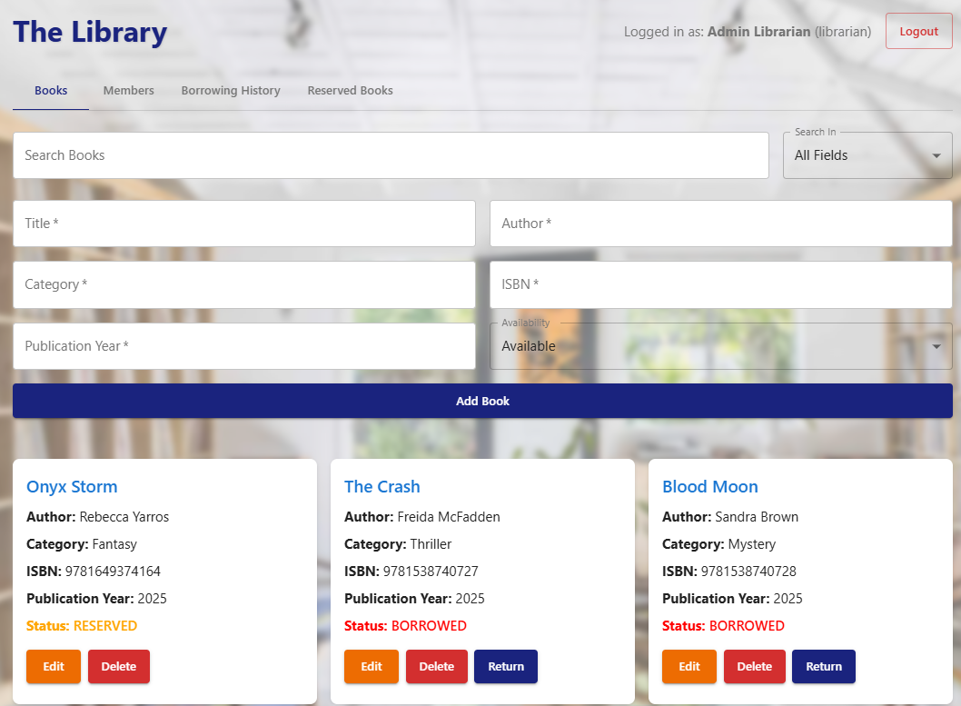
Key features
Return book function
Admin View
Notes:
Here’s the Return Book Function, again only accessible by admins. It updates the book status and makes it available or reserved, depending on the system logic.

Slide 16
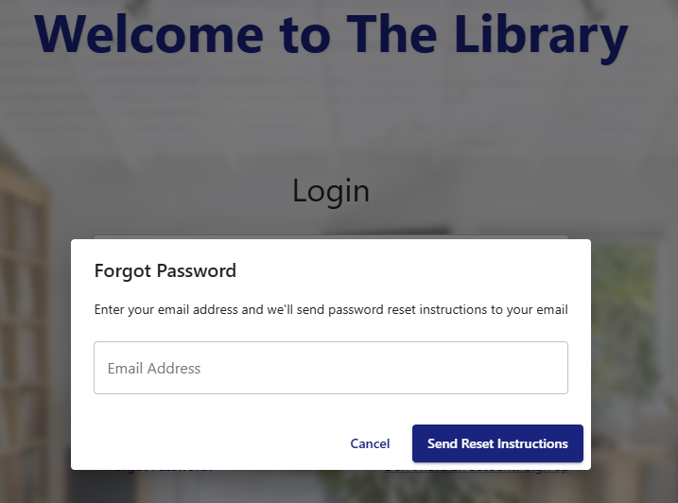
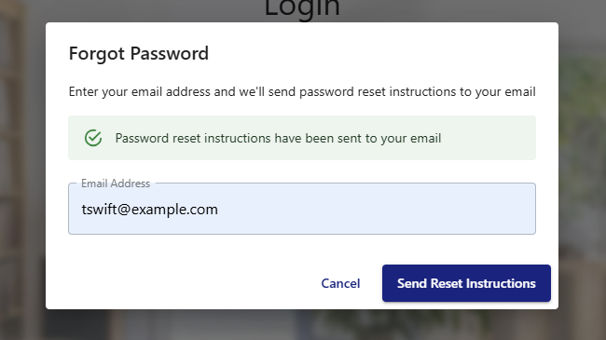
Key features
Forgot Password
Notes:
For account access, I implemented both Forgot Password and Reset Password pages so users can recover their login securely.

Slide 17
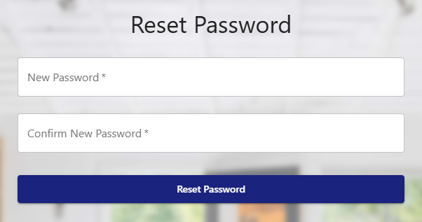
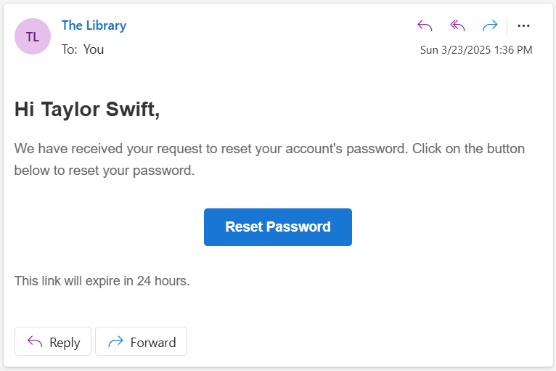
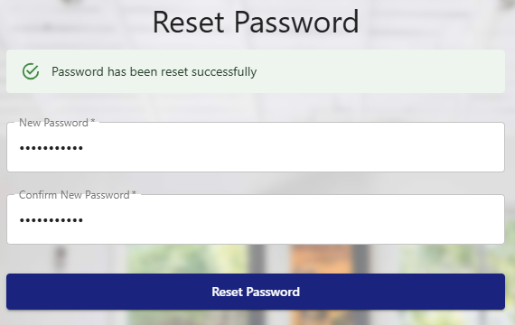
Key features
Reset Password
Notes:
This is the reset password function. When a user resets the password, she will receive an email where she has to click the reset password button and be brought to the reset password page to create a new password.

Slide 18
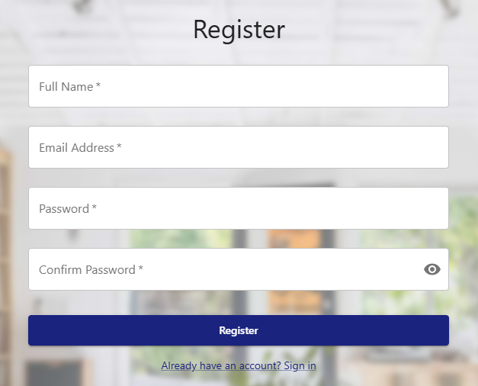
Key features
New User Registration page
Notes:
And finally, here’s the New User Registration Page where members can sign up with their details and join the system.

Slide 19
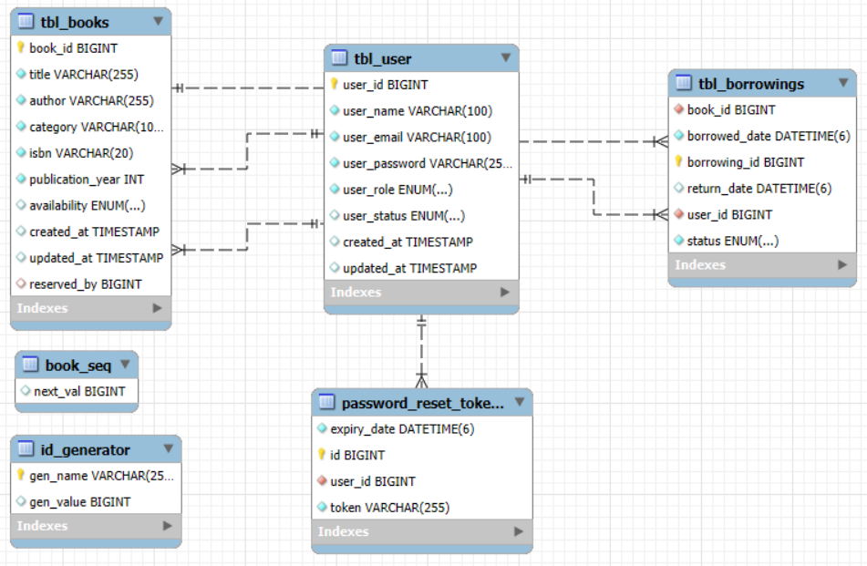
Database & System Designs
Entity Relationship Diagram
Notes:
This is the database design I used in the project. The main tables are tbl_books, tbl_user, and tbl_borrowings.
The tbl_user table stores all user details, including their role and status.
tbl_books holds book information, with a field to track if it's reserved and by whom.
tbl_borrowings connects users and books, recording who borrowed what and when.
There’s also a password_reset_token table to support the forgot/reset password feature.
Auto-increment for IDs is managed in book_seq and id_generator, which I handled using Eclipse instead of MySQL, as guided.
These relationships help enforce the rules of borrowing, reservations, and user management effectively."

Slide 20
API Endpoints
Public | Admin | Member
POST /api/auth/register – Register new user POST /api/auth/login – Login and receive JWT token POST /api/auth/forgot-password – Request password reset POST /api/auth/reset-password – Reset password using token | GET /api/users – View all users POST /api/users – Add a new user PUT /api/users/{id} – Update user DELETE /api/users/{id} – Delete user GET /api/books – View/search books POST /api/books – Add book PUT /api/books/{id} – Update book DELETE /api/books/{id} – Delete book GET /api/borrowings/history/{userId} – View borrowing history PUT /api/borrowings/return/{borrowingId} – Return book | GET /api/books – View/search books POST /api/borrowings/borrow/{bookId} – Borrow book POST /api/reservations/{bookId} – Reserve book
Notes:
Here's a summary of the API endpoints I created for the system.
They are organised into three groups: public, admin, and member.
Under public endpoints, users can register, log in, and reset their passwords.
Admins have full control — they can manage users, books, borrowing records, and returns.
Members can search for books, borrow them, and reserve books that are already borrowed.
Every action in the frontend — like borrowing a book or viewing the list — is connected to one of these endpoints.
I used JWT tokens and Spring Security to ensure each role only accesses what they're allowed to."

Slide 21
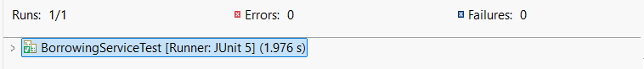
Test Cases – UATs (Just 1 Mockito Test)
✅ Tested Feature: Book Return (Admin Function)
🧪 Testing Tool: Mockito + Junit
🎯 Purpose of Test:
Ensure book status is updated to AVAILABLE
Ensure borrowing record is updated to RETURNED
Verify both changes are saved to the database
✅ Outcome: Test passed successfully
Notes:
For automated testing, I focused on writing one meaningful test using Mockito to prove I understood the testing process.
I chose to test the book return feature because it involves important business logic — updating both the borrowing and book status, and saving those changes to the database.
This test covers how the system behaves when a book is returned, and it gave me the chance to practise mocking dependencies and verifying results.

Slide 22
Challenges and Solutions
Challenge | Solution
Localhost port kept changing (5173 → 5174) | Learned to check the port in the terminal before accessing the app
Forgot to run Spring Boot | Realised the backend must be running before logging in — not a bug 😅
Forgot password emails went to users’ “bogus” emails | Modified the logic in application.properties to send to one fixed email during testing
Members could reserve books they’re currently borrowing (logic bug) | Identified this issue and fixed the codes
Notes:
These were some of the challenges I faced during development.
The frontend port kept changing, and I kept forgetting to update it in the browser — which made me think the app was broken.
I also forgot to run Spring Boot multiple times and spent ages debugging the login, thinking my code was wrong.
The forgot password function worked, but it kept sending emails to fake addresses, so I had to fix it to go to one email for testing.
And I found a logic flaw where members could reserve books they’re already borrowing — Fixed it.
All of these taught me to test carefully, double-check setup steps, and not panic too early!"

Slide 23
Future Enhancements
📱 Mobile app version
Make the system accessible on phones for members to search and reserve books
🧾 Member borrowing history
Add a feature for members to view their own borrowing records
📨 Improved email handling
Allow dynamic email setup for testing and production environments
📊 Admin reporting dashboard
Generate reports on most borrowed books, overdue stats, and member activity
⏰ Overdue book handling
Implement logic to track overdue books and prevent new borrowings if any are overdue
Notes:
Some features I’d like to add in the future include a mobile version for member access and a borrowing history page for members. For the forgot password feature, I’d improve the email configuration so it’s more flexible in different environments. Another useful upgrade would be a reporting dashboard for the admin. And finally, one important rule I didn’t implement yet is overdue book handling — tracking when books are overdue and blocking further borrowings until they’re returned.

Slide 24
conclusion
✅ Completed a full-stack Library Management System using Spring Boot, React, and MySQL
💻 Implemented key features: user login, book borrowing, reservation, admin controls
🧠 Learned backend logic, security, and testing with Mockito
🚀 Grew from no programming background to completing a full project
Notes:
To wrap up, this project has been a huge journey for me. I came into this course with no programming background, and now I’ve built a full-stack Library Management System — with user login, borrowing, reservations, and admin controls. I also managed to write a working test using Mockito, which felt like a big win. I faced a lot of struggles, restarted twice, and nearly gave up, but I pushed through. I’m really proud to have completed this — and thank you for your time.

Slide 25
THANK YOU

